Slide 1

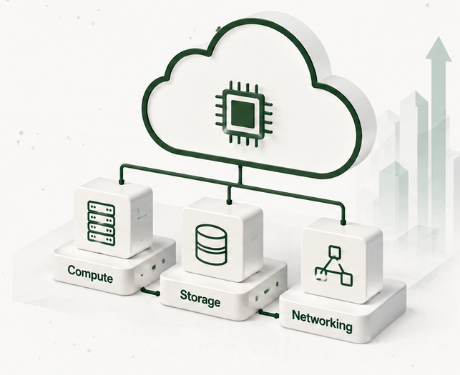




OCI Compute
Migration
Proposed Sizing
Customer
TEST01/07
Date
Jul 01, 2026
Prepared By
Oracle Cloud VMware Specialist
Notes:
[Sources]
Source: user-provided PowerPoint OCI Compute Migration.pptx, slide 1. Oracle logo, sidebar icons, Oracle mark, and OCI Compute illustration are cropped from the provided deck and retained as images. Title, subtitle, customer/date/prepared-by labels and values are recreated as editable PowerPoint text.

Slide 2
























VMware to OCI Compute Migration
Migrate and modernize VMware workloads on Oracle Cloud Infrastructure (OCI).
BUSINESS OUTCOMES
Reduce VMware
licensing costs
Improve performance
and scalability
Leverage OCI native
services and automation
Increase agility and
business innovation
Lower Costs
Reduce VMware licensing
and operational costs.
ON-PREMISES VMWARE ENVIRONMENT
MIGRATION OPTIONS
OCI COMPUTE TARGET ENVIRONMENT
Right-Size Infrastructure
OCI REGION
Optimize compute resources
using OCI Flex Shapes.
VM
VM
VM
...
VM
Oracle Cloud
Migrations (OCM)
OR
Third-Party
Migration Tools
Elastic & Scalable
Your Existing
VMware Environment
Scale resources up or
down as needed.
Oracle-managed
migration services
for VMware workloads.
Partner and ecosystem
migration tools for
specialized workloads.
Production workloads
Virtual Cloud
Network (VCN)
Compute Instances
(Flex Shapes)
OCI Block
Volumes
Cloud Native Modernization
Adopt OCI native services
over time.
Business critical applications
CONNECTIVITY OPTIONS
Users & business operations
Secure & Resilient
At risk from cost, complexity
and technical debt
Secure, scalable and highly available
cloud infrastructure on OCI.
Built-in security and
high availability.
Internet
VPN
FastConnect
Modernize VMware workloads on OCI with flexible compute, managed storage and cloud-native services.
Reduce costs, simplify operations and accelerate innovation.
Reduce VMware dependency while accelerating cloud adoption.
Copyright © 2026, Oracle and/or its affiliates
|
Confidential: Internal/Restricted/Highly Restricted

Slide 3













Current Environment
Analysis based on RVTools data shared by the customer.
Datacenter 1 – CLIENT
VMs
vCPUs
vRAM (GB)
Storage (TB)
20,100
3,000
30,000
210
18,400
Powered On
1,700
Powered Off
Total VMs
Total vCPUs
Total vRAM (GB)
Total Storage (TB)
20,100
3,000
30,000
210
Total Environment
18,400 Powered On
1,700 Powered Off
This sizing is based on the information available at the time of analysis and should be validated during the detailed design phase.
Copyright © 2026, Oracle and/or its affiliates | Confidential: Internal/Restricted/Highly Restricted
Notes:
[Sources]
Source image: user-provided screenshot "Current Environment". Oracle logo, Oracle mark, datacenter icon, metric icons, total-environment icon, and information icon are embedded as cropped image assets from that screenshot. The visible title, subtitle, panel headers, labels, metric values, notes, footer, cards, separators, and decorative background elements are recreated as editable PowerPoint objects.

Slide 4









Assumptions & Methodology
The proposed sizing is based on the information provided by the customer
and the following assumptions and methodology.
Sizing Methodology
Data Source
RVTools export provided by the customer
(Analysis Date: May 08, 2025)
Sizing Approach
Capacity based on current utilization
and projected growth
CPU Contention Ratio
1:6
(Industry standard for medium consolidation)
Average Utilization
vCPU: 50%
vMEM: 60%
Target Utilization
80%
(For both vCPU and vMEM)
Storage Type
OCI Block Volume
(Block Storage)
Copyright © 2026, Oracle and/or its affiliates | Confidential: Internal/Restricted/Highly Restricted

Slide 5









Infrastructure Sizing Summary – OCI Compute
Right-sized OCI Compute infrastructure to support your VMware workloads.
1
WORKLOAD SUMMARY
110
377
1.2 TB
35 TB
OCI Native
Ready
VMs
OCPU
RAM (GB)
Block Volume
83%
Selected in Step 2
Source VM inventory
Priced as flexible memory
Total capacity
Flexible and
optimized
2
COMPUTE MIX (BY SHAPE)
3
STORAGE MIX (BY VPU)
Right-sized compute shapes based on workload requirements
Block Volume storage sized based on VPU requirements
Compute Shape
VMs
OCPU
RAM (GB)
VPU Range (per VM)
Performance Tier
(IOPS)
Typical VPU
per VM
Total VMs
Total VPU
Capacity
VM.Standard.E5.Flex
62
214
684 GB
0 – 20 VPU
Balanced
(10K IOPS)
10
48
320
9.6 TB
VMs
OCPU
GB
VMs
VPU
VM.Standard.E6.Flex
31
124
496 GB
21 – 80 VPU
Balanced
(20K IOPS)
40
44
1,760
17.8 TB
VMs
OCPU
GB
VMs
VPU
BM.DenseIO.E5
17
39
252 GB
81 – 1200 VPU
High Performance
(60K IOPS)
100
18
1,720
7.6 TB
VMs
OCPU
GB
VMs
VPU
TOTAL
110
377
1.2 TB
TOTAL
110
3,800
35 TB
VMs
OCPU
GB
VMs
VPU
VPU ranges and performance tiers per
Oracle Block Volume documentation.
Copyright © 2026, Oracle and/or its affiliates | Confidential: Internal/Restricted/Highly Restricted

Slide 6

Confidential - Oracle Restricted \Employees
Only
Confidential - Oracle Restricted \Employees
Only
Notes:
[Sources]
Source: user-provided PowerPoint OCI Compute Migration.pptx, slide 4. Closing background and confidentiality labels are recreated as editable elements; Oracle logo is retained as a cropped image asset from the provided deck.

